Slide 1




SAHYADRI GROUP
CHICK BROODER TEMPERATURE CONTROL
Information available in audio.

Slide 2



Problem Statement-
Preventing Chickens from Dying Due to Temperature Changes"
Back to Agenda

Slide 3

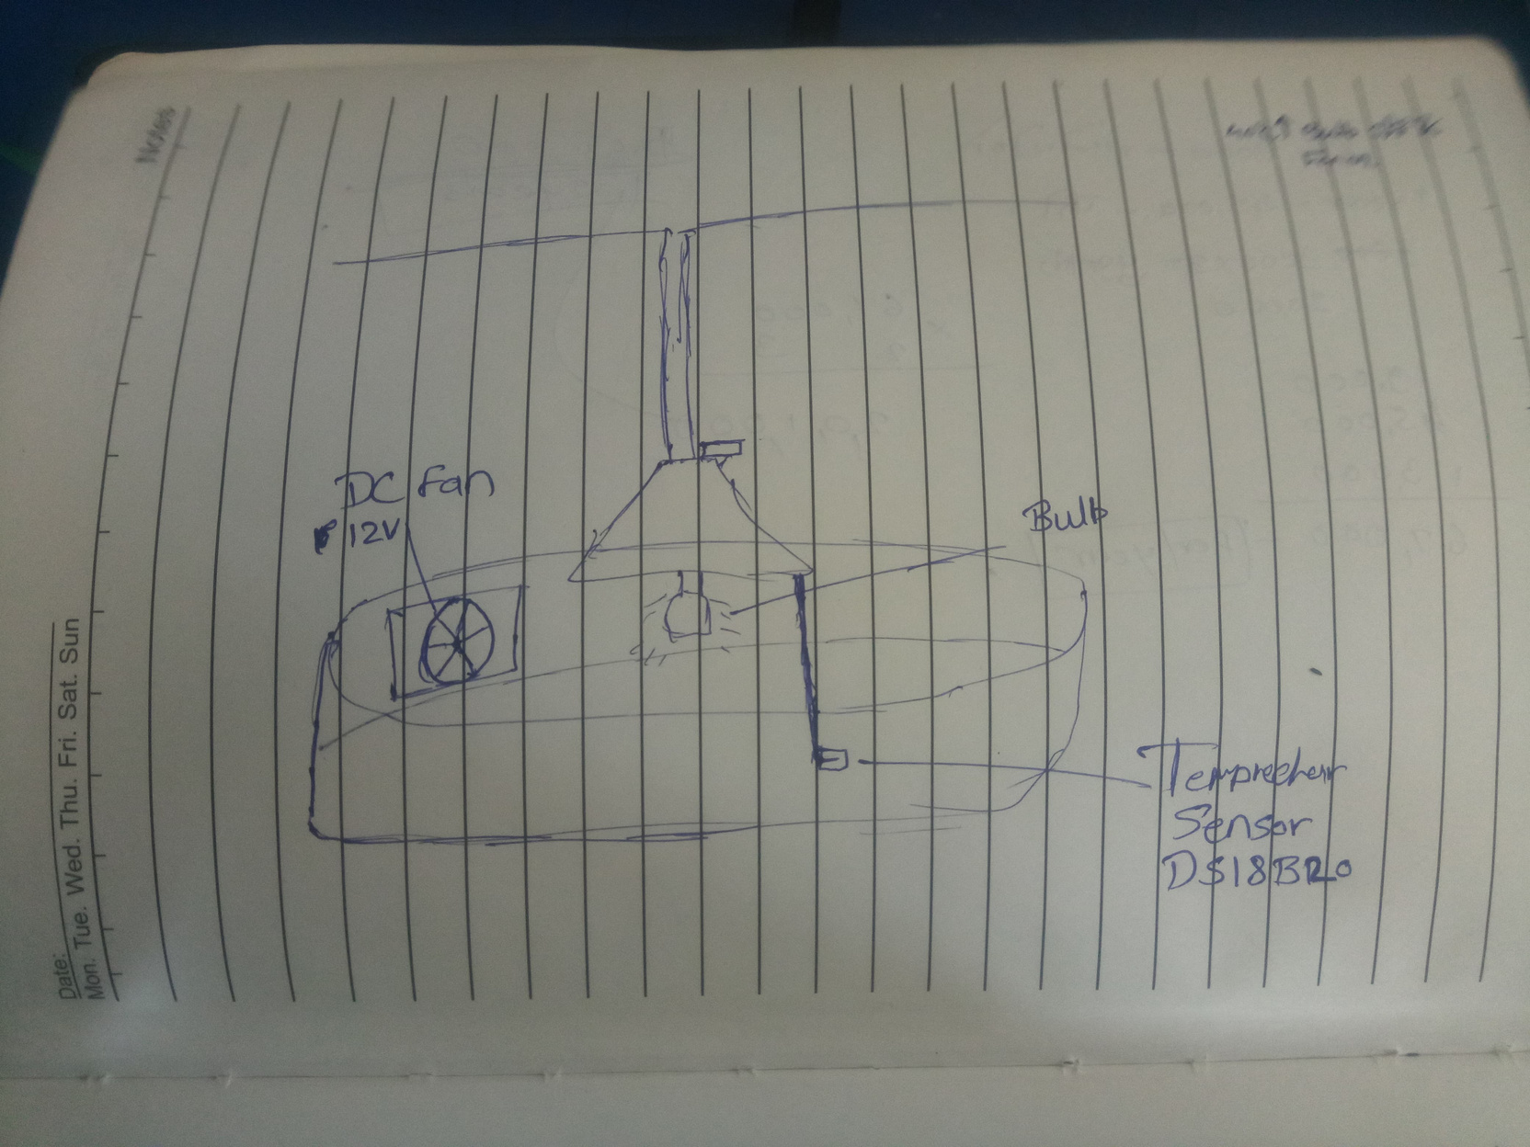
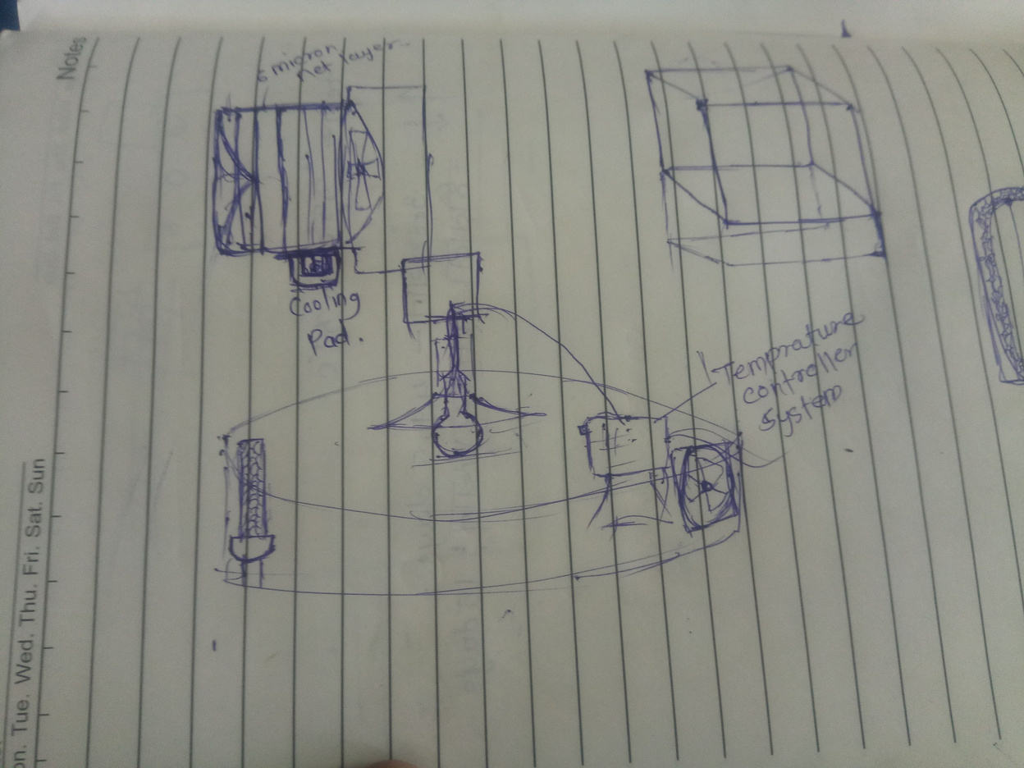
project sketch
EMAIL
hello@sohamvk20@gmail.com

Slide 4
Power Supply(12 V)
Flow Diagram
ARDUINO UNO
Temperature Sensor
(DS18B20)
Chick brooder temperature control system involves several components such as a Temperature sensor, a Microcontroller ,a Relay Module , an Edison Bulb ,and Cooling Fan . Below is a basic sketch outlining the project:
ARDUINO UNO
Relay Module
Edison Bulb
Cooling Fan

Slide 5
Basic Working Principle
In this system:
The microcontroller receives temperature data from the DS18B20 sensor.
Based on the temperature readings, the microcontroller controls the relay module to activate either the heating element (Edison bulb) or the cooling fan as needed.
The relay module acts as a switch, allowing the microcontroller to control the high-power devices safely.
The power supply provides the necessary voltage to operate all components effectively.
This setup ensures efficient temperature control within the chick brooder, promoting the chicks' health and well-being.

Slide 6


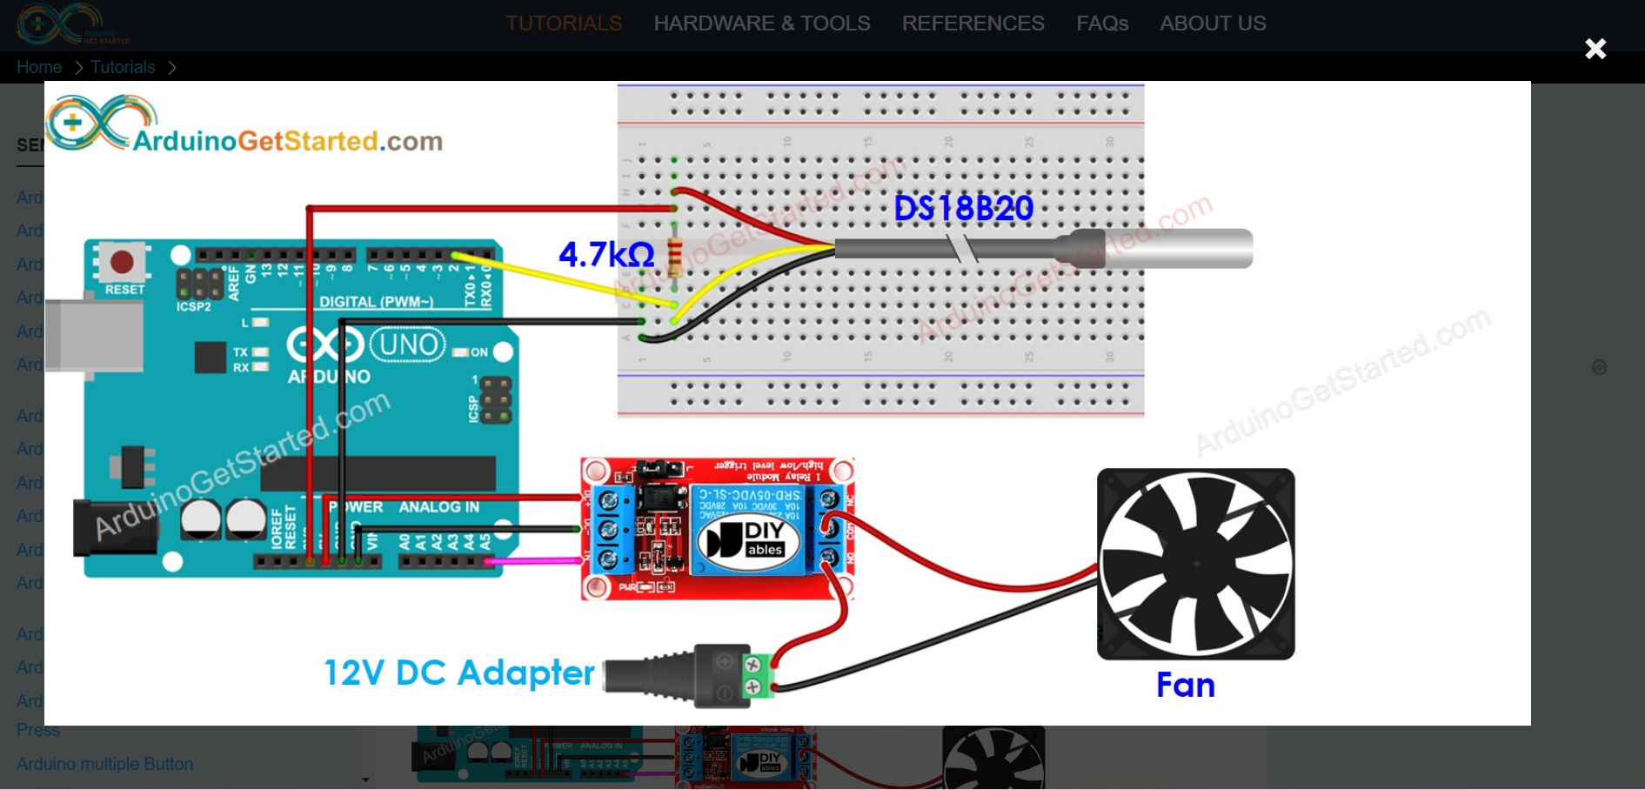




CIRCUIT DIAGRAM

Slide 7
#include <OneWire.h>
#include <DallasTemperature.h>
// Temperature sensor pin
#define ONE_WIRE_BUS 2
// Relay module pins
#define FAN_RELAY_PIN 7
#define BULB_RELAY_PIN 6
// Set the temperature threshold values
#define FAN_THRESHOLD 35 // Temperature above which fan turns on
#define BULB_THRESHOLD 35 // Temperature below which bulb turns on
OneWire oneWire(ONE_WIRE_BUS);
DallasTemperature sensors(&oneWire);
DeviceAddress tempSensor;
void setup() {
Serial.begin(9600);
pinMode(FAN_RELAY_PIN, OUTPUT);
pinMode(BULB_RELAY_PIN, OUTPUT);
sensors.begin();
sensors.getAddress(tempSensor, 0);
sensors.setResolution(tempSensor, 12);
}
void loop() {
sensors.requestTemperatures();
float temperature = sensors.getTempC(tempSensor);
Serial.print("Temperature: ");
Serial.println(temperature);
if (temperature >= FAN_THRESHOLD) {
// Fan ON
digitalWrite(FAN_RELAY_PIN, HIGH);
digitalWrite(BULB_RELAY_PIN, LOW); // Make sure other relay is off
Serial.println("Fan ON");
} else if (temperature <= BULB_THRESHOLD) {
// Bulb ON
digitalWrite(BULB_RELAY_PIN, HIGH);
digitalWrite(FAN_RELAY_PIN, LOW); // Make sure other relay is off
Serial.println("Bulb ON");
} else {
// Neither fan nor bulb
digitalWrite(FAN_RELAY_PIN, LOW);
digitalWrite(BULB_RELAY_PIN, LOW);
Serial.println("No action");
}
delay(1000); // Delay for 1 second before next temperature reading
}
code
created by Shankar sai

Slide 8
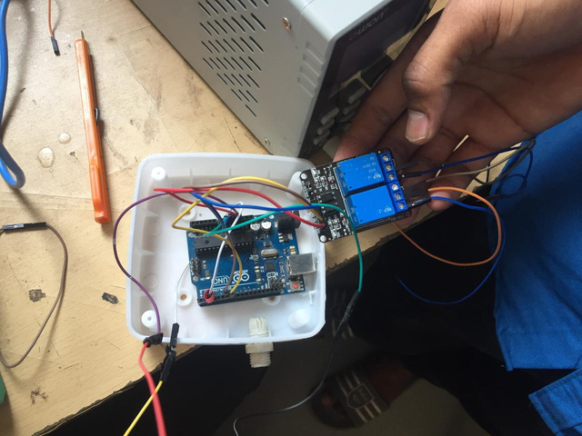

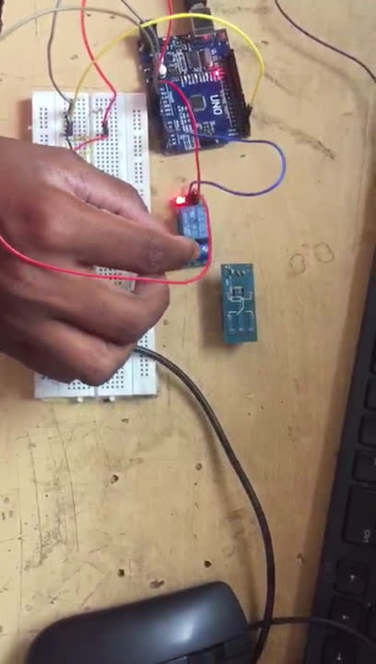
Add Company Name
Assemble
Back to Agenda

Slide 9
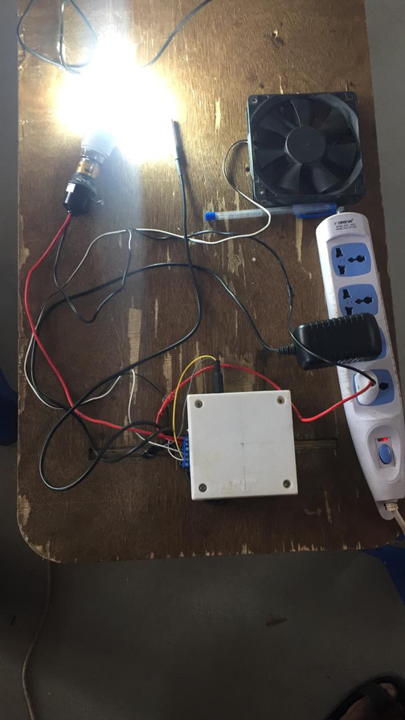
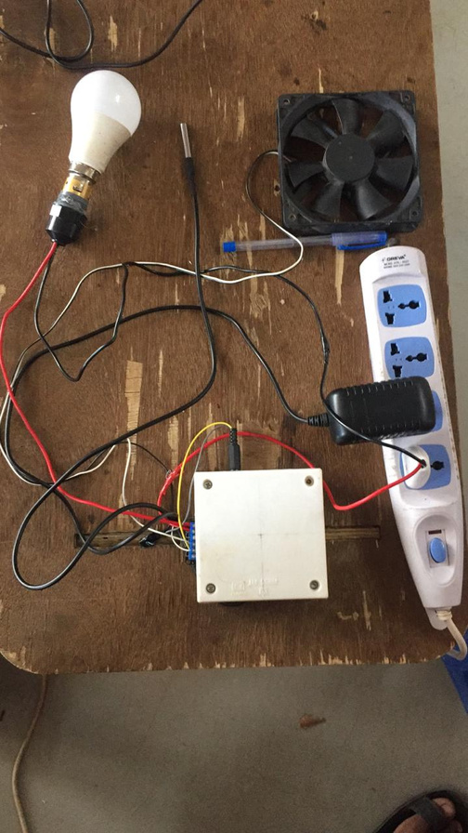
Final project

Slide 10
THANK YOU

